Slide 1

PE 1 3.5 Bubble Sort
Programming Logic

Slide 2

Objectives
By the end of this lesson, you will be able to:
Understand the logic of the bubble sort algorithm
Implement a bubble sort in Python
Use the sort method

Slide 3
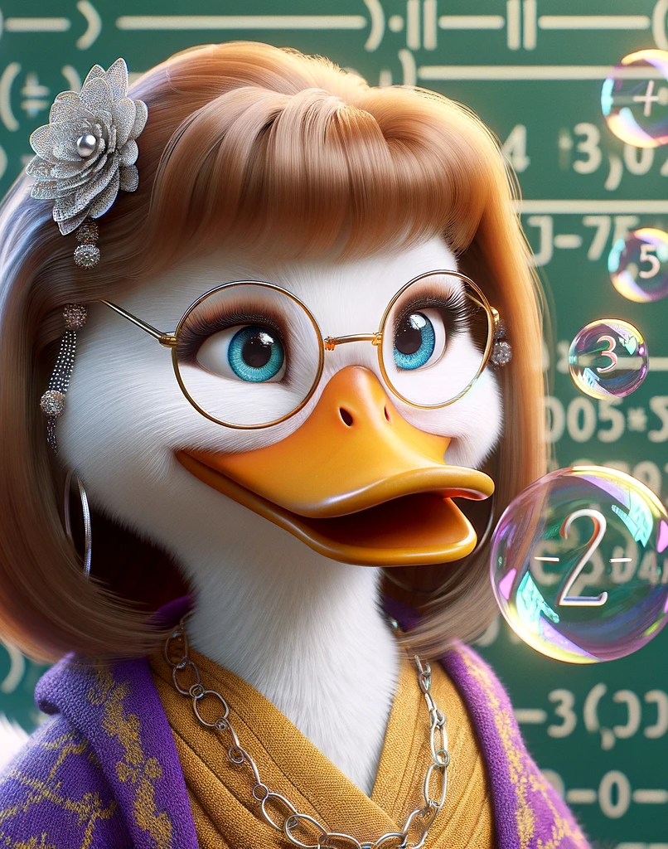
Why Bubble Sort?
It is an important algorithm in programming
You could see it show up on an employment test or interview
Understand how the sort() method works under the hood

Slide 4

Built-in method: sort()
numbers = [3, 1, 4, 1, 5, 9, 2]
numbers.sort()
print(numbers) # Output: [1, 1, 2, 3, 4, 5, 9]
Sort() method – sorts the list in place, modifying the original list

Slide 5
Sorted() function
numbers = [3, 1, 4, 1, 5, 9, 2]
sorted_numbers = sorted(numbers)
print(sorted_numbers) # Output: [1, 1, 2, 3, 4, 5, 9]
print(numbers) # Original list remains unchanged
The sorted() function is used to copy the list, sort it, and store the sorted list in a new variable.

Slide 6
Bubble Sort Algorithm
# Initialize a list of numbers
numbers = [8, 6, 7, 6, 5, 3, 0, 9]
# Flag to track if a swap has occurred
swapped = True
# Continue looping until no swaps occur
while swapped:
swapped = False # Reset the flag at the start of each iteration
for i in range(len(numbers) - 1):
# Compare adjacent elements
if numbers[i] > numbers[i + 1]:
swapped = True # A swap is needed
# Swap the elements
numbers[i], numbers[i + 1] = numbers[i + 1], numbers[i]
# Print the sorted list
print(numbers)

Slide 7
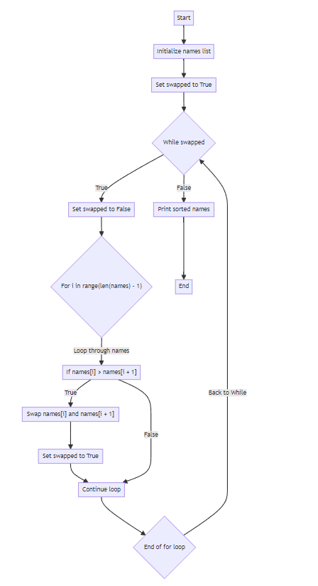
Flowchart

Slide 8
Bubble sort with names
names = ["Bob", "Carol", "Ted", "Alice", "Anna"] swapped = True # flag
while swapped:
swapped = False # Reset the flag
for i in range(len(names) - 1):
# Compare adjacent elements
if names[i] > names[i + 1]:
swapped = True # need swap
# Swap the elements
names[i], names[i + 1] = names[i + 1], names[i]
print(names)

